Slide 1
Collections

Slide 2
JAVA COLLECTIONS
Objectives
Describe simple collection principles & use Java Collections
Chapter content
Collections concepts
Classes & interfaces associated with collections, using Iterators
Sorting Collections, Comparable/Comparator
Static methods of class Collections
Maps
Summary
Collection
List
Vector
Map
Hashtable
Properties
2
Notes:
The way that data is stored and structured in your program can make the difference between a clean, elegant solution and a mass of spaghetti code. We have seen so far that the instance variables of a class can take the place of data structures in other languages and also that we can use arrays to hold many copies of one type of data. However, we often need data containers that are more powerful and flexible than either of these two options. As part of the java.util package, a set of collection classes are provided as ready-made solutions to common data storage problems.
Collections in Java are not type-specific and can hold any type of Object. This makes them a very flexible storage medium. When an item is stored in a collection, it is implicitly cast to an Object. Thus items retrieved from a collection are also returned as Objects. To perform a useful action on the Object, it must therefore be down-cast to a reference of its original type (or one of its super types).
The very flexibility of Java collections brings disadvantages. Since collections are not type-specific, there is no type checking when adding an object. Hence, a collection of Strings can have a Thread object added to it without a murmur from the compiler or runtime. Code which recovers objects from collections should always catch ClassCastException.

Slide 3
Arrays
The simplest form of collection in Java is an array
Contains either primitive types or object references
Bounds-checked & strongly typed!
But fixed size!
May want to improve on arrays for various reasons, e.g.
Easy resizing
More efficient insertion/removal
No duplicates
Sorted as entered, then resorted
Read only
java.util package has a number of collection classes provided to suit your needs
3
Notes:
Very few programs programs in Java will be able to get by without having any one-to-many relationships, hence the need for collections. The simplest way of implementing a one-to-many relationship is to use an array.
Arrays have many benefits which shouldn’t be ignored when deciding on which type of collection you want to use. They can work with any existing type or new User-Defined-Type, without compromising the integrity of your collection, and they provide the most efficient means of direct access and iteration available. However, they also have their limitations, most of which centre around the fact that they can’t be resized. This means that you would have to carry out your own adding and removing of elements.
To avoid the extra work which is sometimes associated with arrays, there are many classes and interfaces provided for you in the package java.util. This chapter will give you an introduction to how they work. For a more detailed account of the Java 2 Collections Framework and the Java 1.1 classes, there is an appendix chapter with this course.

Slide 4
Collections
A collection is simply an object which stores references to other objects
All collections offer the same general features but will be implemented differently
A means of adding/removing/searching for items
A means of finding out the number of elements currently stored
Support for traversing the collection
Were originally as “open” possible, to store any new type
Therefore, only ever stored Object references
But returned only Object references, so downcasting required
Nowadays we use type-safe generics (but you need to know non-generics)
ref
ref
ref
ref
4
Notes:
While different types of collections offer different functionality (as we will see), they are all concerned with the same thing i.e. storing other variables, and so will all offer some common functionality, like adding and removing items. As a result, it should be possible for a user to carry out any of these operations on a collection without necessarily having to know which specific type it is. This is very similar to the way in which we could call getSpeed() on a Car and not need to know which specific type of car it is.
In order to represent this, there is an interface in java.util called Collection which describes the general functionality which all collections should implement. Any class wishing to be considered a collection, should ultimately implement this interface.
One thing to note about all collections in Java is that in order to be extensible (in other words to be flexible enough to work with new types), they must all store an array of Object references, since this is the most generic type available in Java, and all new types which you create implicitly extend from this class.

Slide 5
Collection interface (Java 2)
Common to all collections
int size() boolean isEmpty() boolean contains(Object o) boolean containsAll(Collection c) boolean add(Object o)* boolean remove(Object o)* boolean addAll(Collection c)* boolean removeAll(Collection c)* boolean retainAll(Collection c)* void clear()* Iterator iterator() Object[] toArray()
Object[] toArray(Object[] o)
size of the array
true if no elements
true if collection contains o
true if all of c present
ensures collection contains o
removes one instance of o
adds all of c’s elements
removes all c's elements
remove elements not found in c
remove all elements
A key method!
returns array
returns array, and the output array has o’s runtime type
5
Notes:
A convention exists that Collections should provide a constructor which receives an existing Collection as input. The newly created collection initialises itself to hold the elements of the pre-existing collection. This is only a convention as interfaces cannot define constructor signatures.
add() adds an element to a collection. If the collection is altered as a result of the operation the method returns true. But if a collection already contains the element and does not accept duplicates the collection remains unchanged and returns false. If the element cannot be added to the collection for any other reason (e.g. null elements not permitted), the method should throw an exception.
remove() can remove a single element and returns true if the collection was modified as a result.
addAll(), removeAll() and retainAll() return true if the target Collection was modified. removeAll() will remove all instances of each element contained in the given collection.
toArray() creates a new array with the contents of the Collection. The version of toArray() which accepts an existing array as its parameter allows the caller to choose the runtime type of the output array - which will be the same as the input array. This will only work if all the elements of the collection are of the type of the input array - otherwise an ArrayStoreException is raised.
Note also that if the collection can be fitted into the input array, the input array is populated and used as the output array. If the input array is bigger than the collection the end of the array is filled with nulls.
If the collection specifies the order in which elements are returned during iteration, the same order must be maintained in the array.
The Collection interface also defines equals() and hashCode() in the same way as these methods are defined in java.lang.Object. But see how these methods change in the extended interfaces Set and List.
* these methods are considered optional because you may wish to provide a collection which is unmodifiable. In that scenario, you would still need to implement the methods but would generate an UnsupportedOperationException to indicate that it didn’t work. For a detailed discussion on the pros and cons of this see the online documentation.

Slide 6
Java 2 Collection Interfaces
Collection classes conform to Collection interface
Can be manipulated in standard way independent of implementation
Classes actually implement interfaces that extend Collection
All supplied classes implement all the ‘optional’ methods’
Also all guarantee two constructors (Collection c) and ( )
* Vector is an old 1.0 class retrofitted to fit List
Collection
ArrayList
LinkedList
Vector *
List
Set
HashSet
SortedSet
TreeSet
6
Notes:
This slide shows the possible types of collection available in Java 2. As you can see from the diagram there is a clear structure defined using interfaces which extend from each other. Ultimately they will all be a type of Collection.
Listed beside each interface are the classes provided in java.util which implement them. Note that the Vector class has an asterix beside it. This is because Vector was one of the classes provided with Java 1.1. As a Vector does all the operations which would be expected of a List it has been retrofitted to implement the List interface. This simply means that new methods have been added to the class to match those described in the interface, while the old ones (which would have done much the same things) still remain.

Slide 7
More Specific Interfaces
List is an ordered collection or sequence
Elements may be accessed by their position in the List
Adds some 'index’-related methods that take an int
e.g. add(int i, Object o)
Set is an un-ordered collection of unique elements
No duplicate elements allowed
No extra methods actually added
But some ‘comments’ were!, add() should reject duplicates
Both inherit from Collection
7
Notes:
Lists contain an ordered sequence of elements, which may include duplicates. List elements are indexed by position. The List interface is similar to the functionality of the (Java 1.0) Vector class, and indeed the Vector class has been retro-fitted to implement the List interface.
The List-specific methods all use some form of indexing to access elements.
Set objects are collections which are not permitted to contain duplicates and have no concept of indexing.
The method signatures found in the Set interface are identical to those found in the Collection interface. However, the descriptions of how these methods should operate are more restrictive in the Set interface. Thus the new constraints are semantic rather than syntactic and require discipline on the part of the programmer! The additional constraints are:
add() must not add duplicate elements.
equals() returns true if two sets with identical sizes and elements are being compared.
A Set must not contain itself as an element.

Slide 8
Iteration - Introduction
An object with a reference to a collection wishes to step through the references like one would an array
Both client methods want to simultaneously:
Get a few references, stop for a bit, get a few more
Maybe one does FIFO, one wants LIFO
The collection object needs help(ers), we call them Iterator(s)
Collection containing references
ref1
ref2
ref3
ref4
Has Collection reference
Each client asks for own Iterator (helper) object
I
I
I
now also has a reference
Client1
Client2
passes reference to
ü
8
Notes:
A collection is an object containing a set of references. Another object (o1) has a reference to that collection and might wish to access the 1st 10 references and then stop (for a while). At that point o1 might pass his reference to o2 who wants to also get some references out, but only 5 and starting at the other end (Last In First Out), assumes they are stored in sequence of entry!. Then they will both want in due course to return to the collection and each ask for their respective ‘next’ reference. Who is supposed to keep track of the fact that o1’s ‘next’ reference would be no 11, whilst o2’s next reference would be whatever is 5 from the end?
It is considered too onerous for a collection class to have to keep track of the ‘cursor state’ of a potentially infinite number of client methods that could potentially be running simultaneously in different threads.
So each collection can serve up an infinite number of iterator objects - one per client - that implement the interface called Iterator. All a client can be certain of is that the object returned is capable of telling him whether there is another reference (or are we at end) boolean next() , give me the next reference Object next() and remove the current one void remove().
These iterators are an example of helper objects that we shall look at in more detail when we cover Inner Classes.

Slide 9
Iterator Interface (Java 2)
Core collection interface
public interface Collection { public Iterator iterator(); …… }
Ask any ‘collection’ to return an Iterator
Use it to cycle through the collection
3 methods boolean hasNext(), Object next(), void remove()
Separates the storing of the items from the traversal
Can have as many Iterators as necessary over the same collection
Code for traversing collection independent of how the data is stored (i.e., collection class)
9
Notes:
The Iterator interface provides a standard set of APIs for moving through a Collection, retrieving data and (optionally) removing elements. It is an improved version of the Java 1.0 Enumeration classes.
hasNext() simply returns true or false to indicate if there is a further item in the collection.
next() retrieves the next element as an Object.
The remove() command, if supported, removes the last element to have been retrieved using either next() or previous()(List interface).
The Iterator is returned by the Collection's iterator() method. The List's listIterator() method returns a ListIterator which supports by-directional access and access through indexing.
Having a separate object (the Iterator) to the traversal of a collection is a standard design pattern as it allows the collection to focus on what it is good at (storing items) without having to worry about keeping track of cursors, etc. This also allows us to have a standard way of cycling through the elements of a given collection without needing to know anything about how the data is actually stored. This in turn helps to make the client code more generic.

Slide 10
Using Lists - FIFO example
Library class has a collection of books
Use ArrayList implementation
Note the Iterator variable
Library.java
public class Library { private List books; private Iterator bookIter;
public Library() { books = new ArrayList(); books.add(new Book("War and Peace")); books.add(new Book("Sense and Sensibility")); books.add(new Book("Crime and Punishment"));
Book b = (Book) books.get(2); // cast Object } }
note 'interface' type
10
Notes:
In the example, the Library class contains a simple List collection, using the ArrayList class, which has been initialised in the Library constructor and for simplicity, filled up with newly constructed Book objects.
Note that if we were using a different type of collection the code would still look much the same, e.g.
private Set books;
…
public Library()
{
books = new HashSet();
books.add(new Book("War and Peace")); books.add(new Book("Sense and Sensibility")); books.add(new Book("Crime and Punishment"));
}

Slide 11
Using Lists - FIFO continued
Use the Iterator
Get an Iterator via the collection's iterator() method
next() method always returns an Object reference, so must downcast it to specific type
Library.java
public void display() { bookIter = books.iterator();
while (bookIter.hasNext()) { Book aBook = (Book) bookIter.next(); System.out.println(aBook.title()); } }
iterator ‘idiom’
11
Notes:
The Iterator object bookIter is returned by invoking the collection's iterator() method. bookIter is then used to cycle through the Book object collection. In this case, since the purpose of the display() method is to display books, each invocation of next() will access a Book object and print the book's title.
Again, if we were using a different type of collection (e.g. a HashSet as used in the notes for the previous slide) the code within display() wouldn’t need to change.

Slide 12
Generics
Java 5 introduced 'typed' objects
Particularly useful for Collections
Class contains a 'type' parameter in < >
Java 7 allows object type to be omitted
The 'diamond operator'
Compiler can see the declared type on the left-hand side
List<Book> books = new ArrayList<Book>(); books.add(new Book("War and Peace")); ...
Book first = books.get(0); // no cast } }
List<Book> books = new ArrayList<>();
12

Slide 13
Iteration and the for-Loop
Loop through the elements of a collection without casting
Can also use enhanced for-each syntax, as with arrays
This construct can be used with any type that implements Iterable
Don't need explicit Iterator
Only limitation is it doesn't allow remove() to be called
public void display() { Iterator<Book> bookIter = books.iterator();
while (bookIter.hasNext()) { Book b = bookIter.next(); System.out.println(b.title()); } }
public void display() { for (Book b : books) { System.out.println(b.title()); } } // compiler generates identical code!
13

Slide 14
Removing an Element
Loop through the elements to remove conditionally
MUST use Iterator's remove() method!
Removes element at current position
Using the collection's remove(...) could wreck the collection!
e.g., other iterators might be using the collection, by index
Results in ConcurrentModificationException
public void removeExpensive(double limit) { Iterator<Book> bookIter = books.iterator();
while (bookIter.hasNext()) { Book b = bookIter.next();
if (b.price() > limit) {
bookIter.remove(); // no parameter
} } }
14

Slide 15
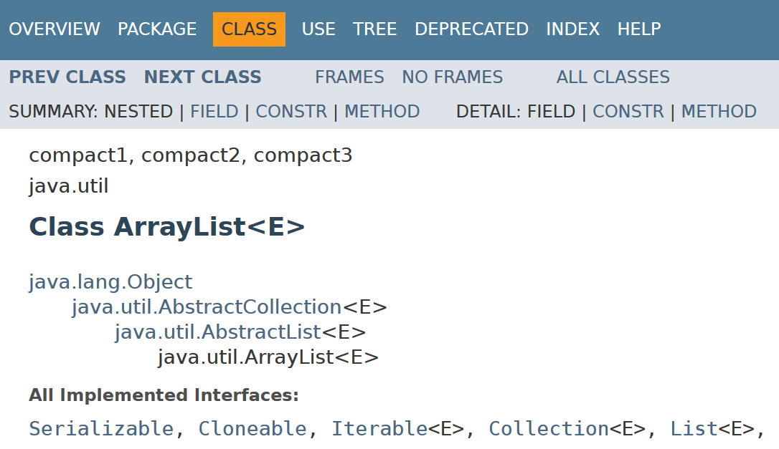
Documentation of Generic Types
Javadoc shows the type as an alias 'E' (for element)
A class declared this way is supplied the desired type on instantiation
The 'E' is consistent throughout the class code
15

Slide 16
ArrayList and Vector Implementation
ArrayList and Vector backed up by ordinary array
Internal resizing is achieved by API
Initial capacity constructor argument (10 by default)
Approximately trebles in size with each growth
List interface has add() and remove() methods by index
Elements may need to be repositioned
Fast access by index
null
16
Notes:
Page 16

Slide 17
LinkedList Implementation
LinkedList backed up by doubly-linked Nodes
List interface has add() and remove() methods by index
Adjacent links need to be repaired
Slow access by index
Nodes have to be traversed
remove(2);
17
Notes:
Page 17

Slide 18
HashSet Implementation
HashSet backed up by hashed buckets
Element's hashCode() determines location
Internal resizing is achieved by API
Initial capacity constructor argument (16 by default)
Load factor determines collision limit (75% by default)
Subsequent rehashing
Fast adding and retrieving (contains())
18
Notes:
Page 18

Slide 19
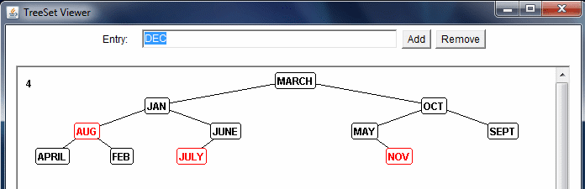
TreeSet Implementation
The TreeSet class uses binary tree algorithm
Structure determined by Comparable or Comparator
Tree rebalancing determined by red-black algorithm
Depth of tree kept minimal by local 'rotations'
Decent modifying and retrieving (log N comparisons)
But sorted structure is usefully maintained
19
Notes:
Page 19

Slide 20
Sorting Collection entries
Java has sorting algorithms in java.util
Uses 'Timsort' (modified form of Mergesort)
You have to supply the sorting criteria for your own objects
Comparable for internal sort criteria
Comparator for externally applied criteria
public interface Comparable<T> { int compareTo(T t); }
public interface Comparator<T> { int compare(T t1, T t2); }
20
Notes:
The Comparable interface defines the default natural ordering of objects. Any class may choose to implement it.
However, occasionally an alternative sort sequence of objects will be required. A separate interface Comparator enables this. Multiple 'Comparator' classes can be written each of which can be capable of sorting objects (by generating an appropriate int value) from their respective implementations of the int compare(Object o1, Object o2) method.
See overleaf for code samples of how these interfaces can be used.

Slide 21
Example use of Comparable
public class Person implements Comparable<Person> { …
public int compareTo(Person p) { return this.age - p.age; } }
assume instance data of name, age, plus getName( ), getAge( )
Overly simplistic!
Set<Person> personSet = new TreeSet<>(); personSet.add(person1); personSet.add(person2);
Collections.sort(aPersonList); Arrays.sort(aPersonArray);
2 persons sorted by age
Classes full of static methods
21
Notes:
The TreeSet class will sort objects according to their natural ordering (Comparable) assuming the empty constructor is used.
TreeSet also has several overloaded constructors one of which takes a Comparator reference which will of course determine the sequence of the objects when added.
The Collections.sort(List) method orders the List’s elements in accordance with the results of the compareTo() function as defined in the Comparable interface - using polymorphism to ensure the appropriate ordering of elements. The compareTo() function is designed to determine the “natural” ordering of objects, but if a sort by an alternate criteria is desired, an overloaded version of sort() may be used which accepts both a List and an object implementing the Comparator interface. A Comparator compares two objects and returns an int (zero if both objects are regarded as equal(), negative if the first object is placed before the second object, and positive otherwise). The Comparator should implement Serializable so that the host Collection can be saved. sort() uses an optimized version of the merge sort algorithm which is fast and stable. Partially sorted lists are dealt with quickly, and the algorithm is guaranteed to run in n log(n) time. Equal elements are not reordered during subsequent sorts.
Similar functionality exists in class Arrays, a class again full of static methods for manipulating arrays.
The sort method again is overloaded and one version takes a Comparator reference as a 2nd parameter as shown above.

Slide 22
Example use of Comparator(s)
public class SortByName implements Comparator<Person> { public int compare(Person p1, Person p2) { String name1 = p1.getName(); String name2 = p2.getName(); return name1.compareTo(name2); // String compareTo() } }
Have as many SortByXXX classes as necessary
enables
Set<Person> persons = new TreeSet(new SortByName());
Collections.sort(aPersonList, new SortByName());
Arrays.sort(aPersonArray, new SortByName());
ü
22
Notes:
The TreeSet class will sort objects according to their natural ordering (Comparable) assuming the empty constructor is used.
TreeSet also has several overloaded constructors one of which takes a Comparator reference which will of course determine the sequence of the objects when added.
The Collections.sort(List) method orders the List’s elements in accordance with the results of the compareTo() function as defined in the Comparable interface - using polymorphism to ensure the appropriate ordering of elements. The compareTo() function is designed to determine the “natural” ordering of objects, but if a sort by an alternate criteria is desired, an overloaded version of sort() may be used which accepts both a List and an object implementing the Comparator interface. A Comparator compares two objects and returns an int (zero if both objects are regarded as equal(), negative if the first object is placed before the second object, and positive otherwise). The Comparator should implement Serializable so that the host Collection can be saved. sort() uses an optimized version of the merge sort algorithm which is fast and stable. Partially sorted lists are dealt with quickly, and the algorithm is guaranteed to run in n log(n) time. Equal elements are not reordered during subsequent sorts.
Similar functionality exists in class Arrays, a class again full of static methods for manipulating arrays.
The sort method again is overloaded and one version takes a Comparator reference as a 2nd parameter as shown above.

Slide 23
Collections Operations
Collections class defines operations on collections
copy(), shuffle(), reverse(), fill(), binarySearch(),
min(), max(), ...
Collections.EMPTY_SET
Collections.EMPTY_LIST
Collections.singleton(singletonElement)
Creates an immutable singleton Set holding specified element
Generic
Operations
myCollection.removeAll(Collections.singleton(element)); Set fixedSet = Collections.unmodifiableSet(aSet);
23
Notes:
The Collections class defines static methods which perform operations on Maps, Collections and Collection sub-types, although many of these operations are specific to Lists.
copy(destinationList, sourceList) copies elements from the source list to the destination list (which is of an equal or greater length). The ListIterator belonging to the destination list must support the set() method - otherwise an UnsupportedOperationException results.
shuffle() reorders a List using a random input to insure that all possible permutations occur with equal likelihood. Two versions of this method exist - one takes a List and uses a default source of randomness, the second takes an addition parameter of the java.util.Random class.
binarySearch(list, element) looks for an element in a sorted list and returns either the position at which it is found, or, if not found, the index of the position where the element would be placed if inserted into the list, multiplied by -1, and then subtracted by 1. (Always a negative value).
min() and max() give the position of an extreme element in the collection (as defined by either a natural ordering or in accordance with a specified Comparator object). fill(list, value) overwrites all elements in an existing List with the specified value.
In addition the Collections class can be used to generate some standard implementations, such as the empty Set, the empty List and a Singleton Set containing exactly one element.

Slide 24
Map Interface
Not inherited from Collection
Map 'maps' keys on to values
No duplicate keys allowed, each key can map on to one value
Values only accessed through key
Can iterate over the keys, values, or the combined pair
HashMap
Hashtable*
Map
Bristol | 01179
Torquay | 01803
Cirencester | 01285
Newton Abbot | 01626
SortedMap
TreeMap
Map<String,String> m = new HashMap<>(); m.put("Bristol","01179"); Iterator<String> keyIter = codeMap.keySet().iterator();
24
Notes:
The Map interface defines operations over collections which map keys to object values.
The Map interface defines standard operations such as put(), get(), remove() etc;
There are also methods for returning views of sections of the Map - such as the set of keys or the collection of values within the Map. Note that it is these views, which can then return an iterator which can be used to navigate through the Map. Any changes made on a view of the Map will be carried through to the underlying Map implementation.
keySet() returns a Set of keys.
values() returns a Collection of values.
entrySet() returns a Set of key value pairs each of which is of type Map.Entry
Map.Entry is a nested interface with methods getKey(), getValue() and setValue()

Slide 25
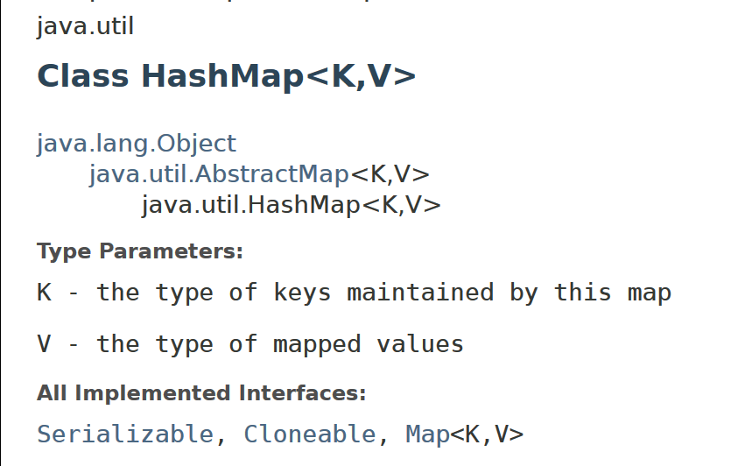
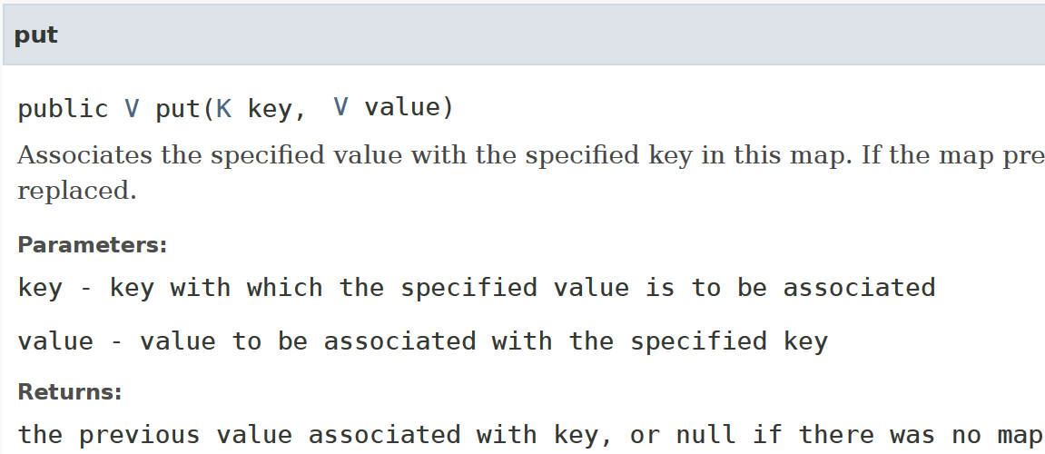
HashMap Javadoc
Maps have two generic type parameters
K = 'key'
V = 'value'
Used throughout class
Supplied when the object
Is created, as usual
25

Slide 26
Generic Maps
HashMap<Key,Value> implements Map<Key,Value>
public class TelCodes { private Map<String, String> codeMap; public TelCodes() { codeMap = new HashMap<String,String>(); codeMap.put("Bristol", "01179"); codeMap.put("Torquay", "01803"); for (String s : codeMap.keySet()) System.out.println("Town is " + s);
for (Map.Entry<String,String> me: codeMap.entrySet()) System.out.println("Town is " + me.getKey() + " Code is " + me.getValue()); } }
26
Notes:
Not surprisingly there are generic version of the interfaces Map, SortedMap and Map.Entry with the Java 5 framework as well as corresponding generic classes and they combined with the new for loop enable the code to be more concise and type safe than Java Version 2 equivalent.

Slide 27
AutoBoxing, Generics, & Enhanced for
Making a frequency table becomes simple
public class Freq { public static void main(String[] args) { Map<String, Integer> m = new TreeMap<String,Integer>(); for (String word : args) { Integer freq = m.get(word); m.put(word, (freq == null ? 1 : freq + 1)); } System.out.println(m); } }
Auto unboxing & boxing
Autoboxing
27
Notes:
Java will auto convert (box) an int to produce an Integer whenever it is necessary, plus it will unbox an Integer extracting the underlying int value just as implicitly.

Slide 28

Date
Date represents time in milliseconds (UTC)
Two constructors:
No argument version returns current Date
Use long to set time in milliseconds since epoch
getTime() returns time in milliseconds
Compare two Date objects with:
after(aDate), before(aDate), compareTo(aDate), equals(anObject)
toString() prints time in standard format:
dow mon dd hh:mm:ss zzz yyyy
Java 8 introduced package java.time
Much more advanced, handles timezone offsets
Navigation rules, e.g. 'same time next week', etc.
28
Notes:
The Date class is used to represent a time in milliseconds based on Universal Co-ordinated Time (UTC).
The no-argument Date constructor creates a Date object representing the current date and time, or you can use the version of Date’s constructor which takes in a long representing time in milliseconds since the epoch (1st of January 1970). The method getTime() returns the time in milliseconds since the epoch.
Dates can be compared either explicitly by recovering each Date’s long UTC time value or by use of the before(), after() and equals() methods which do the comparison for you.
The toString() methods prints the time in standard format:
dow mon dd hh:mm:ss zzz yyyy
dow: day of week (Mon, Tue, Wed etc)
mon: month (Jan, Feb etc)
dd: day (1 - 31)
hh: hours (0 - 23)
mm: minute
ss: seconds
zzz: time zone
yyyy: year as 4 digits

Slide 29
Calendar - an Internationalised Date
Java 1.0 Date class returned Day, Month, Year etc
Insensitive to difference in calendars around the world
Java 1.1 introduced Calendar classes
Parse UTC time into specific calendar representation
e.g. GregorianCalendar converts to D/M/Y BC / AD
Methods to get / set day, month, year
Locality may also be set
GregorianCalendar cal = new GregorianCalendar(); System.out.println("DAY_OF_MONTH: " + cal.get(Calendar.DAY_OF_MONTH)); System.out.println("DAY_OF_YEAR: " + cal.get(Calendar.DAY_OF_YEAR)); System.out.println("DAY_OF_WEEK: " + cal.get(Calendar.DAY_OF_WEEK));
29
Notes:
The no-argument GregorianCalendar constructor creates an object representing the current date and time. Once you have your Calendar object, you can query it for information such as year, month, hour, etc. with the appropriate get method using constants defined in the Calendar class.
You can also recover a Date from a Calendar or initialise a Calendar using a Date.

Slide 30
Formatting Dates
DateFormat classes provide dates as text
Concrete subclasses is SimpleDateFormat
Deals with internationalisation issues
Language
Order of month, day, etc.
See package java.text for other formatting classes
SimpleDateFormat df = new SimpleDateFormat("EEEE, MMMM yy 'a' hh 'heurs' ", Locale.FRANCE); Date theDate = new Date(); String dateString = df.format(theDate); System.out.println(dateString);
mardi, novembre 99 a 06 heurs
30
Notes:
In Java 1.0 the Date class was responsible for displaying dates as text strings, but to accommodate internationalisation, this functionality has been moved to DateFormat classes in java.text.
Symbols for SimpleDateFormat are as follows:
G era designator AD
y year 1996
M month in year July & 07
d day in month 10
h hour in am/pm (1~12) 12
H hour in day (0~23) 0
m minute in hour 30
s second in minute 55
S millisecond 978
E day in week Tuesday
D day in year 189
F day of week in month 2 (2nd Wed in July)
w week in year 27
W week in month 2
a am/pm marker PM
k hour in day (1~24) 24
K hour in am/pm (0~11) 0
z time zone Pacific Standard Time
' escape for text (Delimiter)
'' single quote (Literal) '

Slide 31
SUMMARY
Collections, lists, and sets
Concepts, classes, and interfaces
Iterators
Using Lists, FIFO, and LIFO
Sorting, Comparable & Comparator
General Purpose Implementations & Collections
Generics
For-each loop
Maps
Utilities
Date and Calendar and Formatting
31

